Slide 1

Cisco UI Kit
July 2018

Slide 2
Our Collective Mandate
“It’s imperative that our teams adopt a consistent look and feel, and that other groups, specifically software, embrace it”
Chuck Robbins
CEO

Slide 3
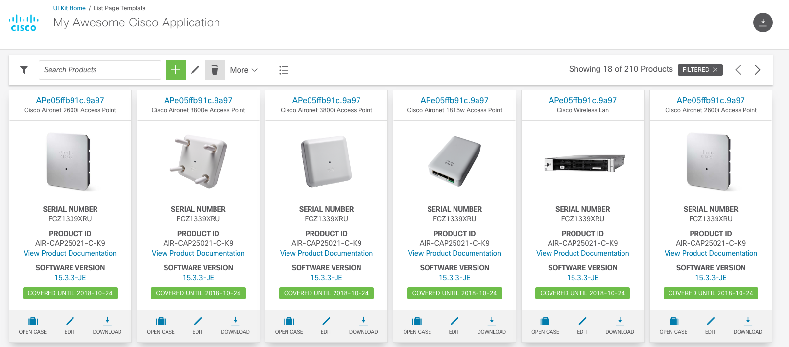
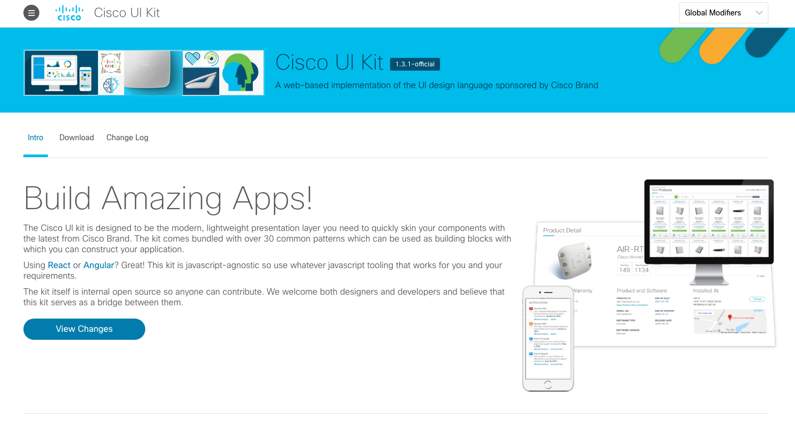
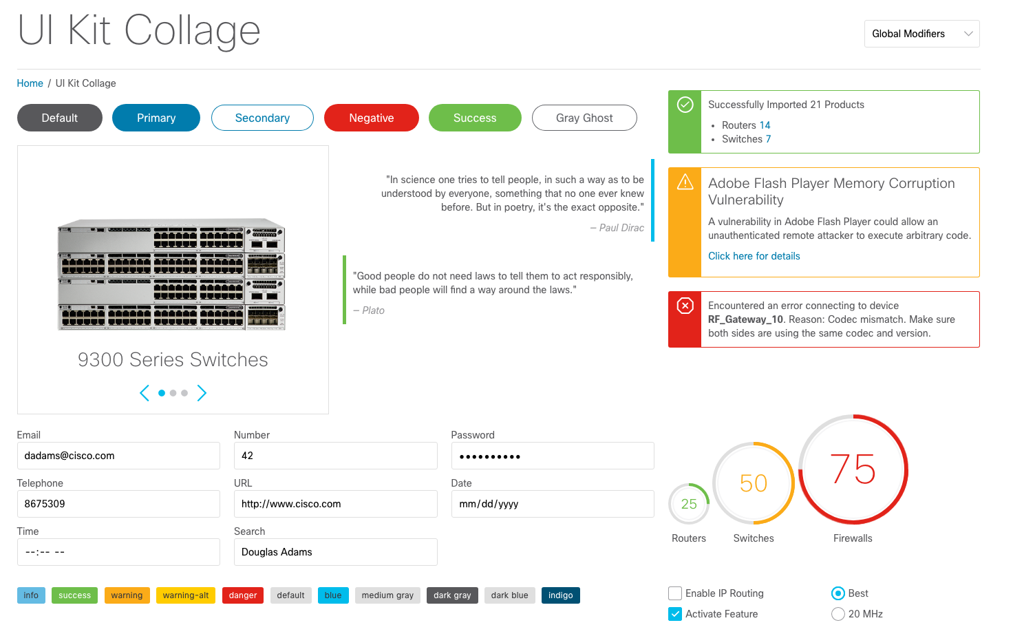
Cisco UI Kit

Slide 4
History
Originated in Services (Project Apollo) early 2015
Intended primarily to maintain consistency in the UI across multiple teams
Separates the presentation layer from javascript tooling
Services and Brand worked closely to build out the kit
Over 100+ web applications now built on the kit across Cisco
Currently on version 1.2 (6 releases)

Slide 5
What is it?
The Cisco UI Kit is simply the presentation layer (CSS + HTML)
It contains no Javascript leaving the Javascript framework tooling up to the individual teams
The kit is made up of 30+ patterns built to the original redline specifications from Cisco Brand
The kit makes use of modern tools and best practices (SASS, mobile-responsive, BEM syntax, multi-browser support)
Governance exists as a multi-disciplinary group made up of UI designers, visual designers, and UI developers
Governance council is comprised of Cisco.com (Dave Ngo / Everardo Filho), Cisco Brand (Shanaz Sarlak / Lisa Fedele), Services (Kevin Broich / Matt Zellmer), and Cisco Hatch (Robert Ellis)

Slide 6
Benefits
The kit is FREE and internal open source
Tracks closely with Cisco Brand getting periodic updates (every 6-10 weeks)
Teams can leverage the kit allowing them to focus on the business logic saving time and $$
Drives consistency across applications
It is the only kit in Cisco approved and sponsored by Cisco Brand
Applications which build according to the kit’s patterns will get updates which require NO changes to their code
Across Cisco groups have formed to collectively build out a set of reusable components in Angular and React using the internal open source model

Slide 7
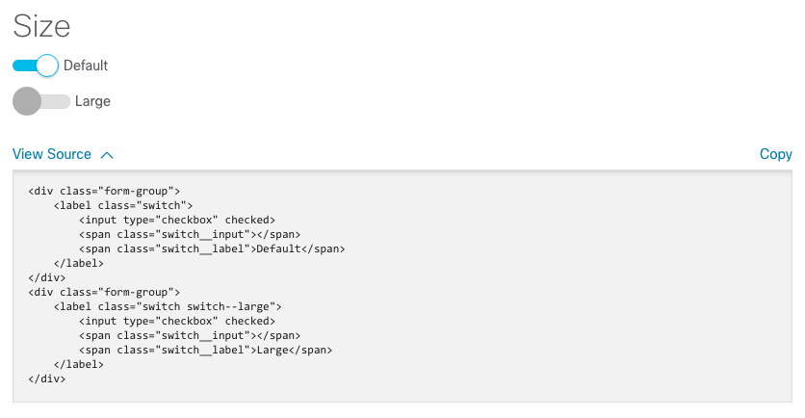
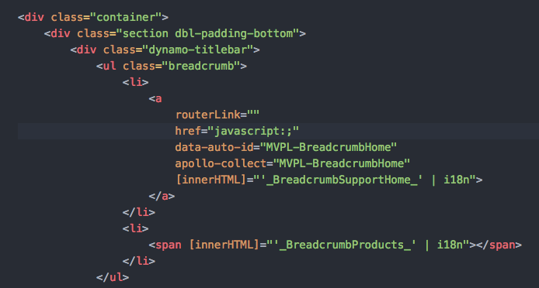
How Does it Work?
Developers simply copy HTML from the Cisco UI kit docs and paste it directly into their code. Requires a single, compressed CSS file which contains all the patterns.

Slide 8
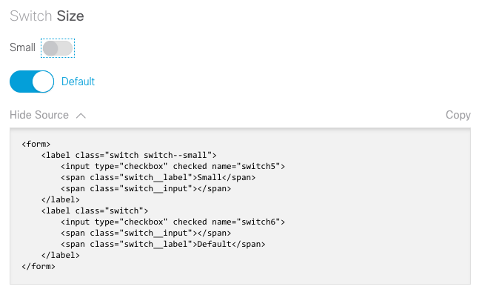
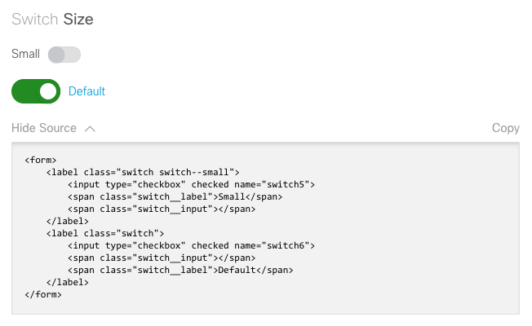
How Does it Work?
Future updates to a pattern require NO change to the application it was used in. Just point your application to the new version of the kit.

Slide 9
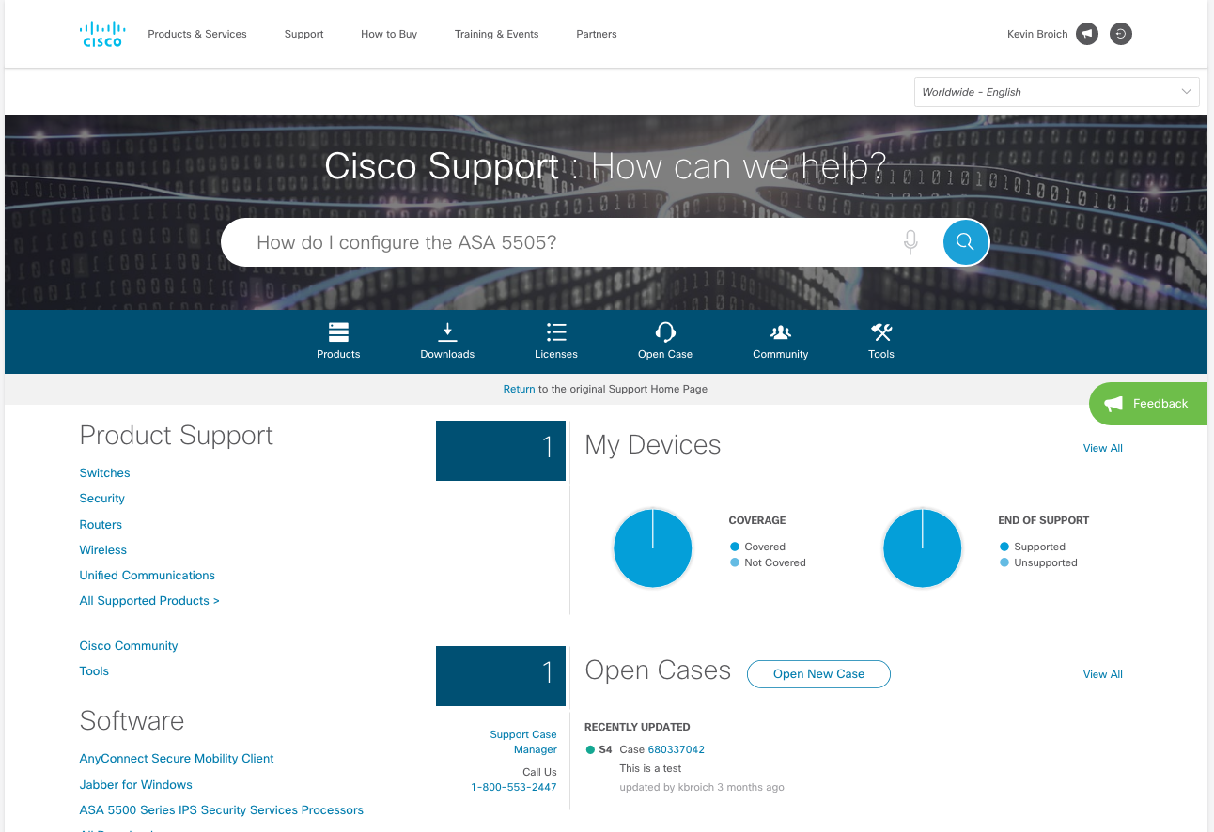

UI Kit Example
Cisco.com Support / ^{Project DSX}

Slide 10
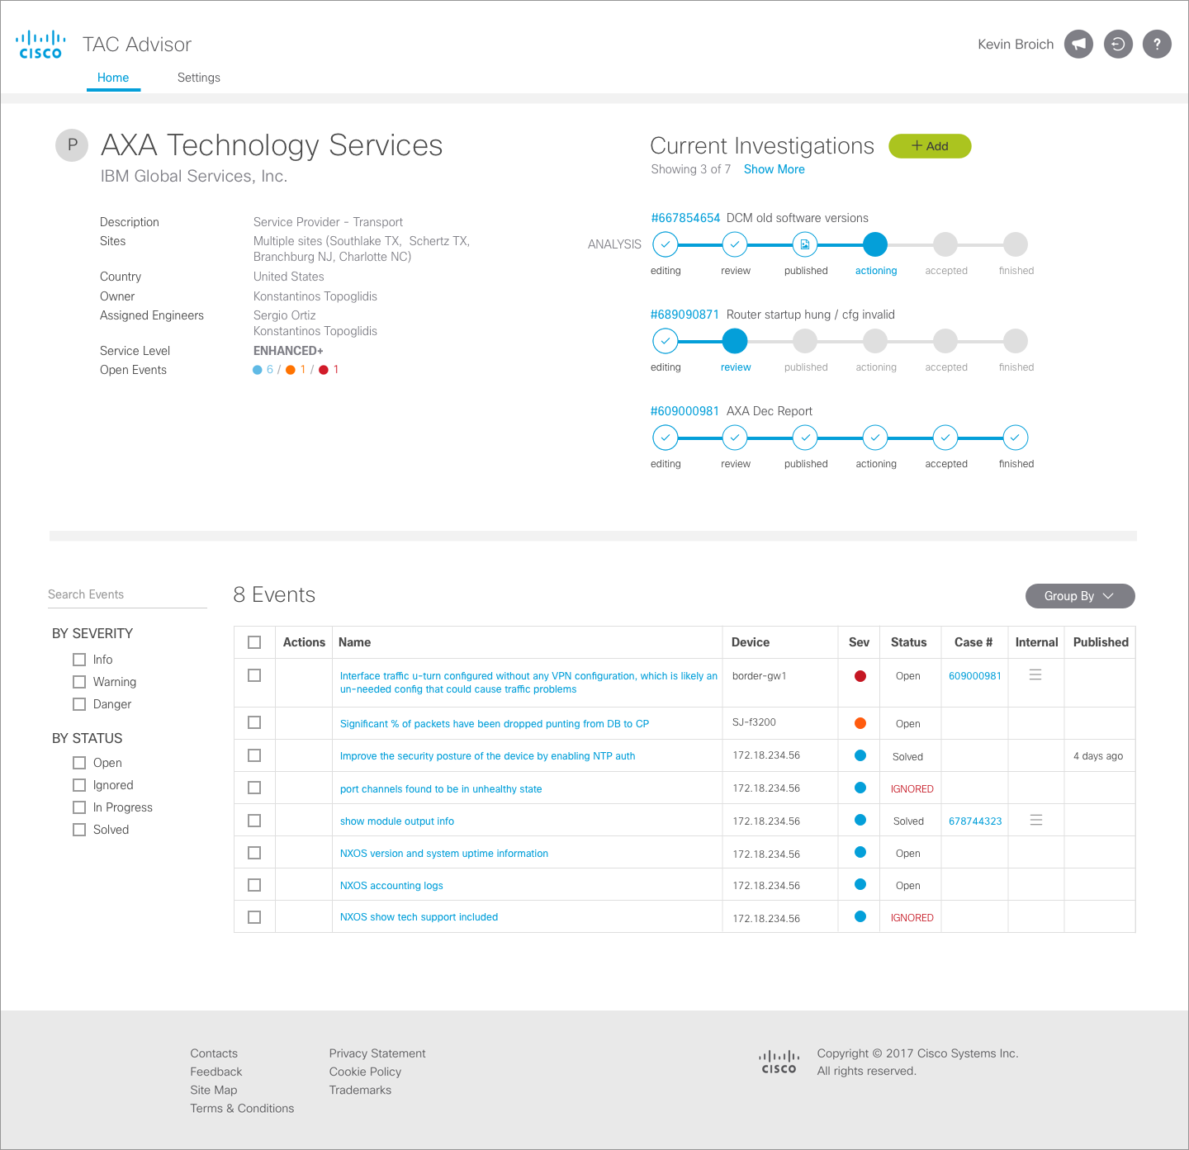
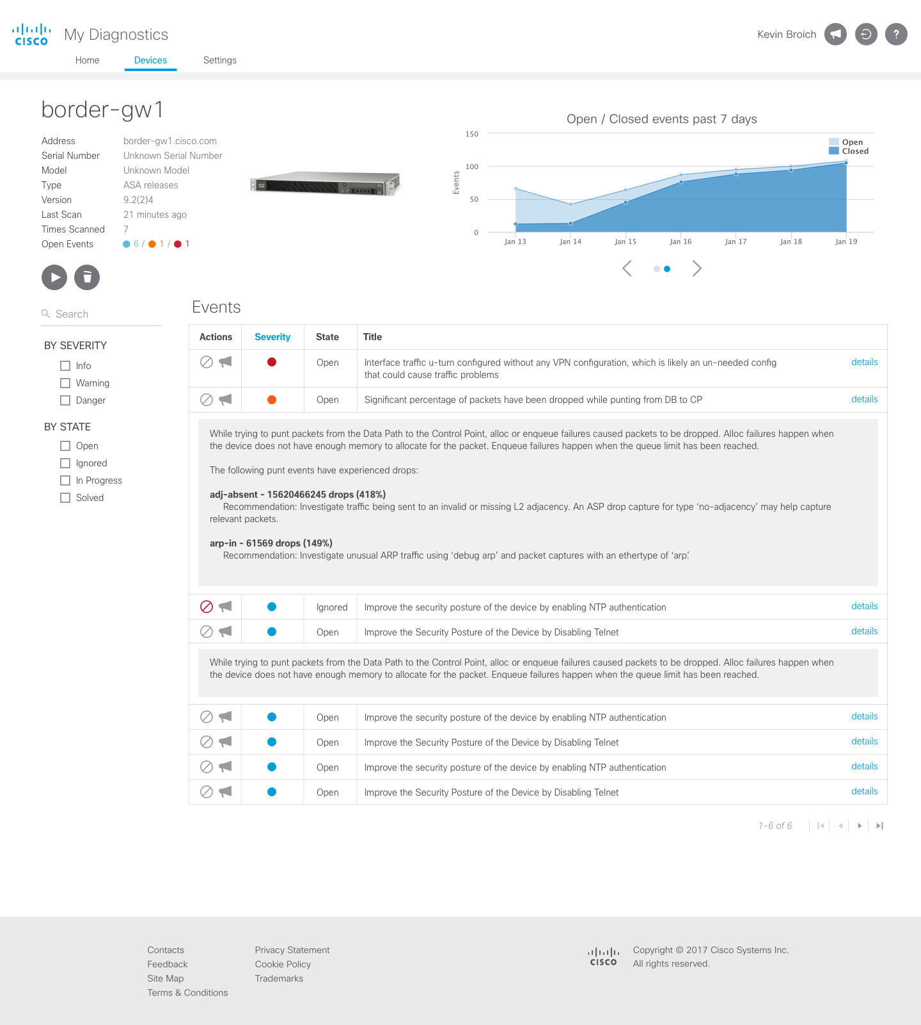

UI Kit Example
My Diagnostics / ^{Project Connected TAC}

Slide 11
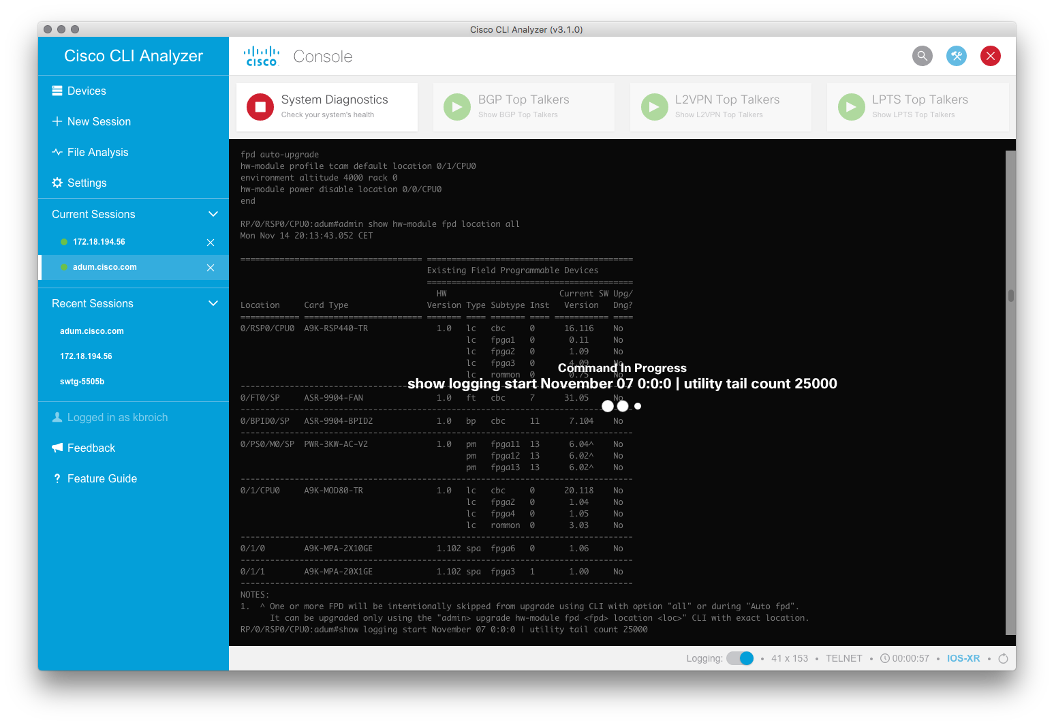
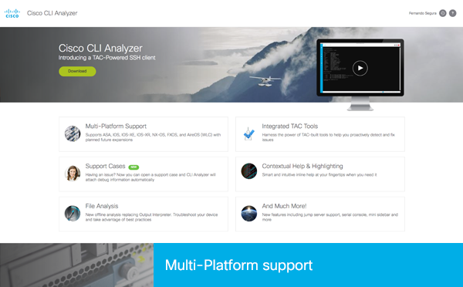
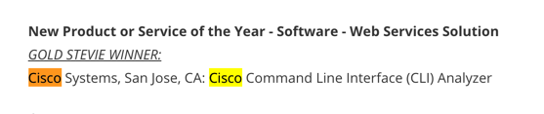
UI Kit Example
CLI Analyzer / ^{SSH client}

Slide 12
Resources
Cisco Brand Home
https://cisco.jiveon.com/groups/atlantic/pages/about
Cisco UI Kit Documentation
http://cisco-ui.cisco.com/
Cisco Brand Exchange
https://bx.cisco.com/cbx-portal/

